Slide 1
Topological Reasoning
Jonathan Lo, Tommaso Peletta, Adrien Razurel

Slide 2





A Spatial Model Checker
Model
Model Checker
Result
$$φ$$
Formula

Slide 3
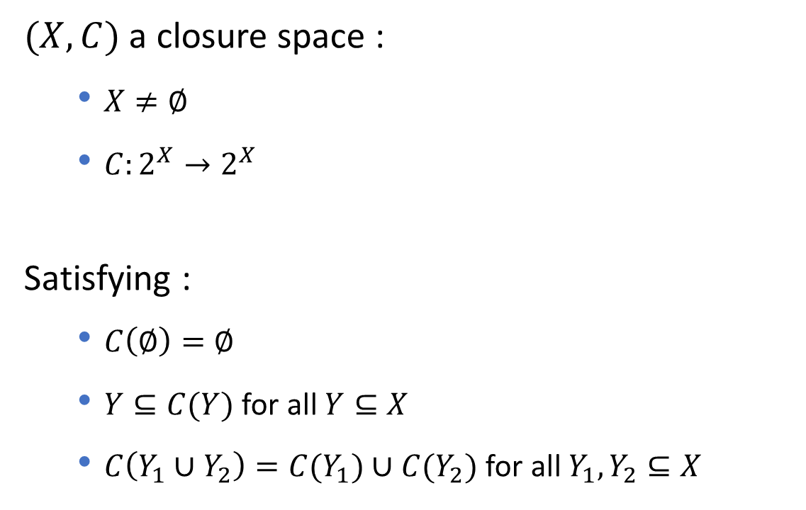
Closure space
$(X,C)$ a closure space :
$X≠∅$
$C:2^{X}→2^{X}$
Satisfying :
$C\left(∅\right)=∅$
$Y⊆C(Y)$ for all $Y⊆X$
$C\left(Y_{1}∪Y_{2}\right)=C(Y_{1})∪C(Y_{2})$ for all $Y_{1}, Y_{2}⊆X$

Slide 4
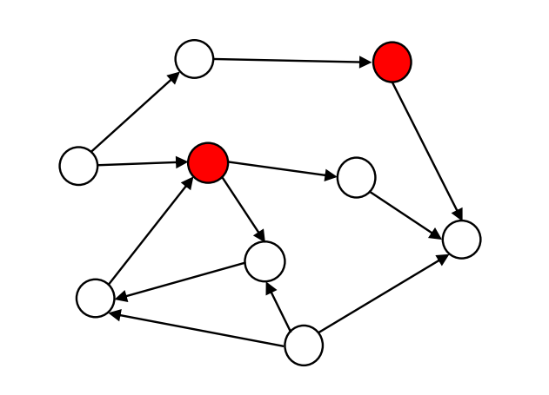
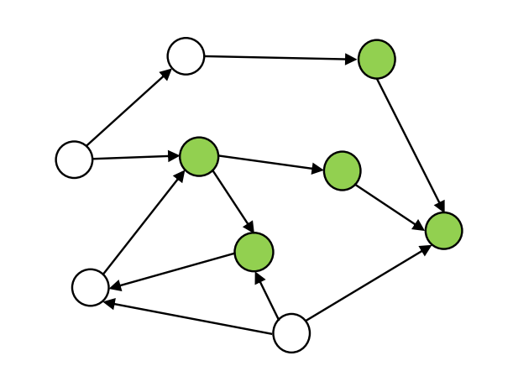
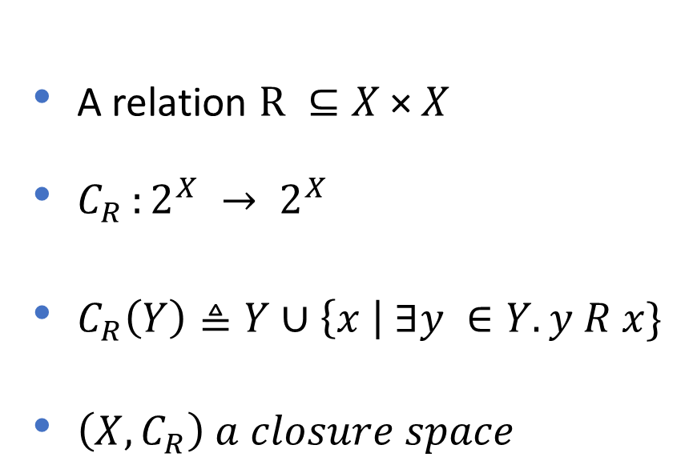
Quasi-discrete closure space
A relation $R ⊆X \text{×} X$
$C_{R }:2^{X} → 2^{X}$
$C_{R}\left(Y\right)≜Y∪\left\{x \right| ∃y ∈Y.y R x\}$
$\left(X,C_{R}\right) a closure space$

Slide 5

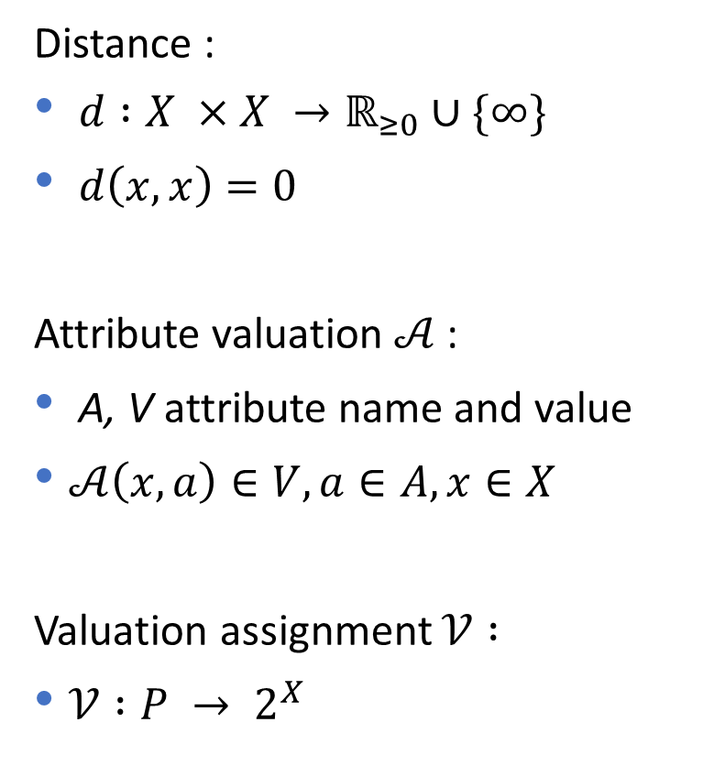

Enrichment
Distance :
$d :X ×X →ℝ_{≥0}∪\{∞\}$
$d\left(x,x\right)=0$
Attribute valuation $𝒜$ :
A, V attribute name and value
$𝒜\left(x,a\right)∈V, a∈A, x∈X$
Valuation assignment $𝒱 :$
$𝒱 :P → 2^{X}$
$$x$$
$$𝒜\left(x,color\right)=red$$

Slide 6
Satisfaction of a formula
z
y
z
y
w
x
c
w
x
c
b
b
d
d
t
t
a
a
Red
{x,y}
Red
{a,b,c,d,t,w,z}

Slide 7
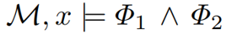
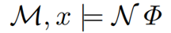
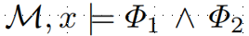
Satisfaction of a formula
z
y
z
y
w
x
c
w
x
c
b
b
d
d
t
t
a
a
Red
Green
{x}
Red
{c,d}

Slide 8
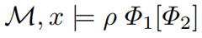
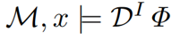
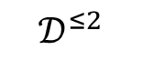
Satisfaction of a formula
z
y
z
y
w
x
c
w
x
c
b
b
d
d
t
t
a
a
$$𝒟^{≤2}$$
{d,c,b,t}
Green [Red]
{w,z}
Red

Slide 9
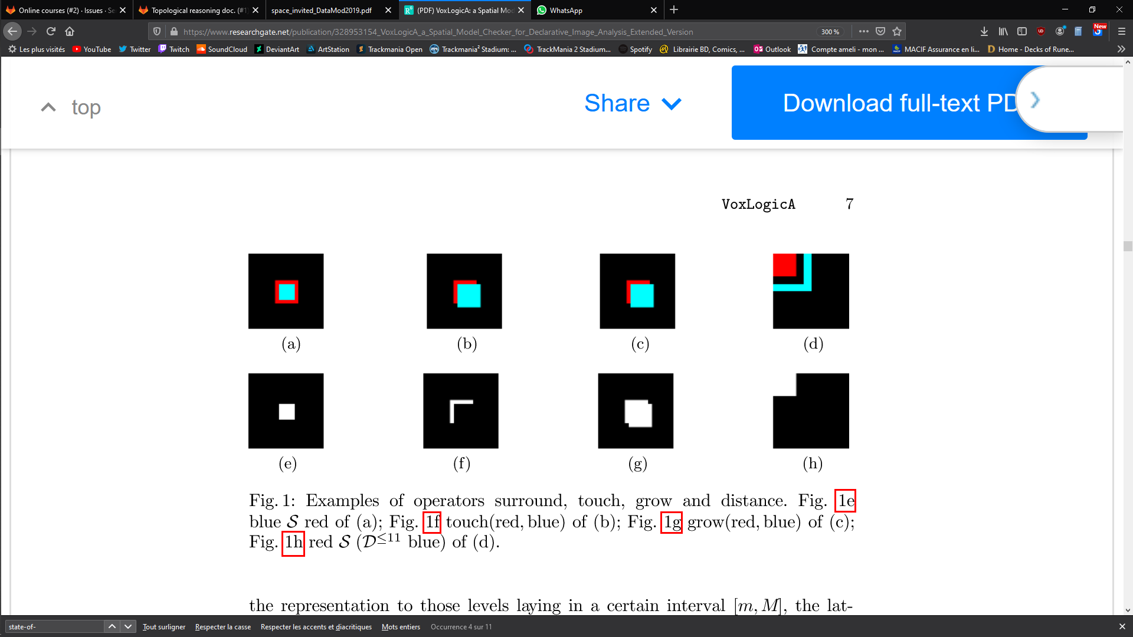


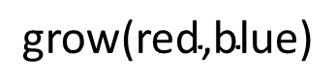

Derived Operators
blue$𝓢$red
$$\text{touch}\text{(}\text{red}\text{,}\text{blue}\text{)}$$
$$\text{grow}\text{(}\text{red}\text{,}\text{blue}\text{)}$$
$$\text{red} 𝓢 \text{(}𝒟^{≤11} \text{blue}\text{)}$$

Slide 10
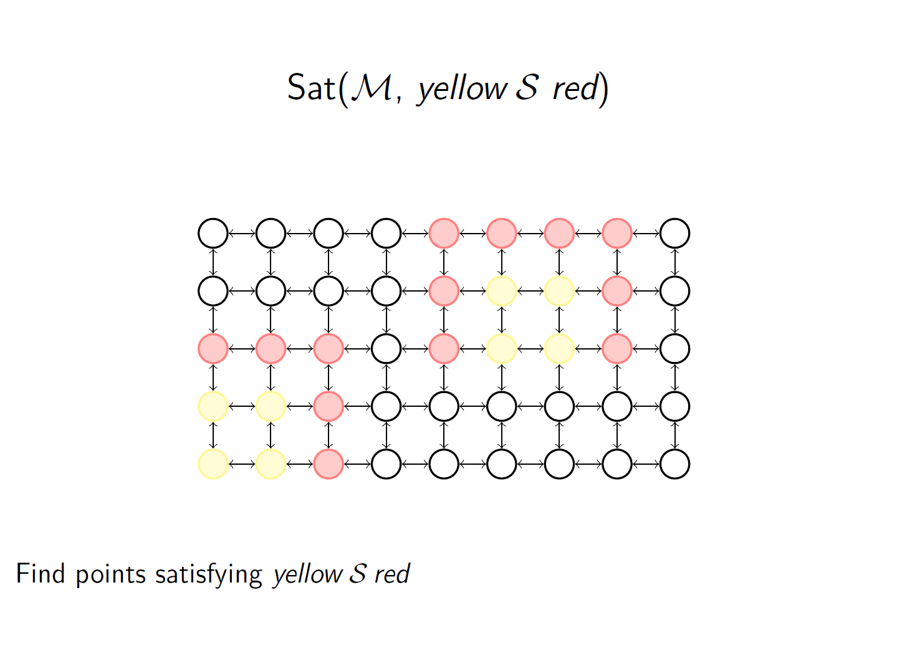
Example

Slide 11
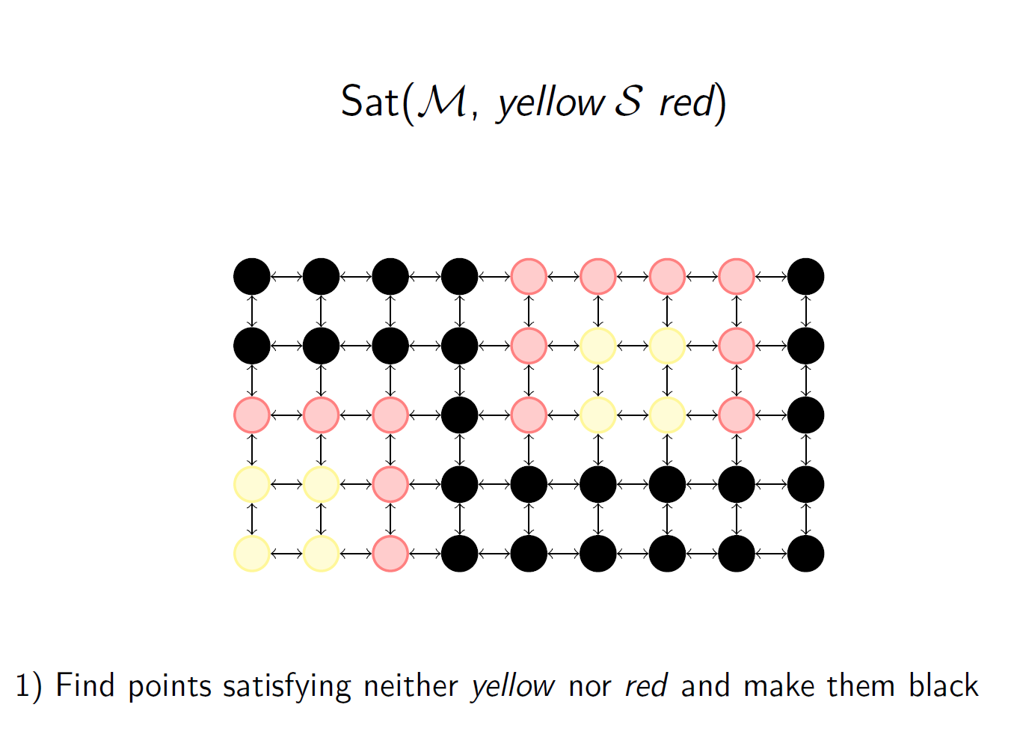
Example

Slide 12
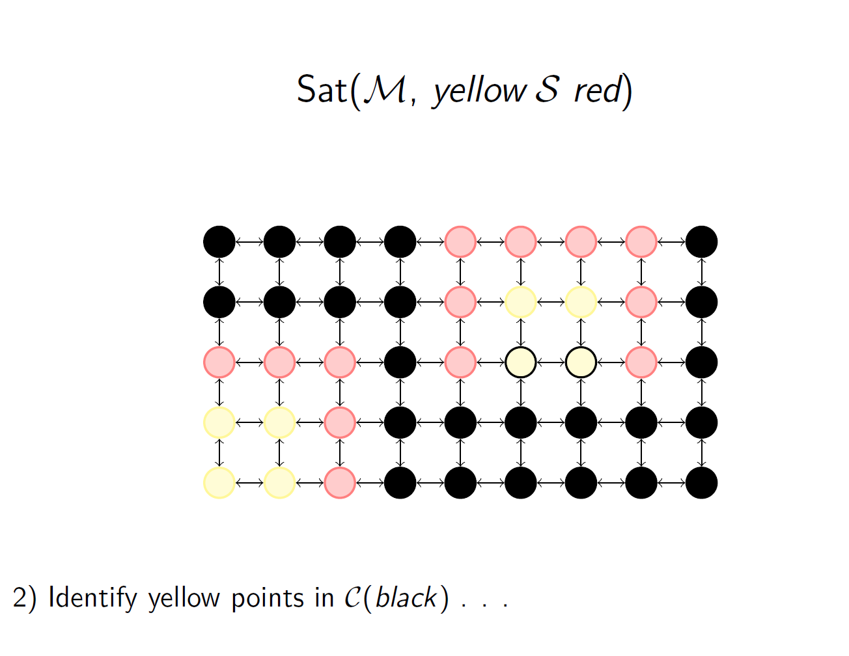
Example

Slide 13
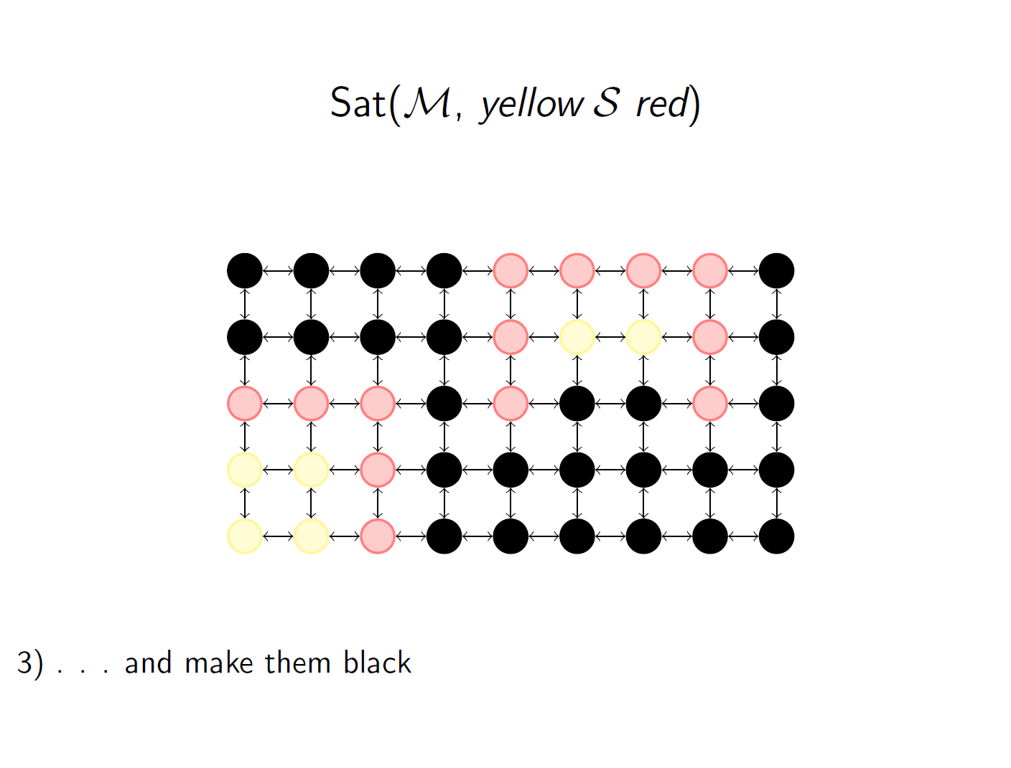
Example

Slide 14
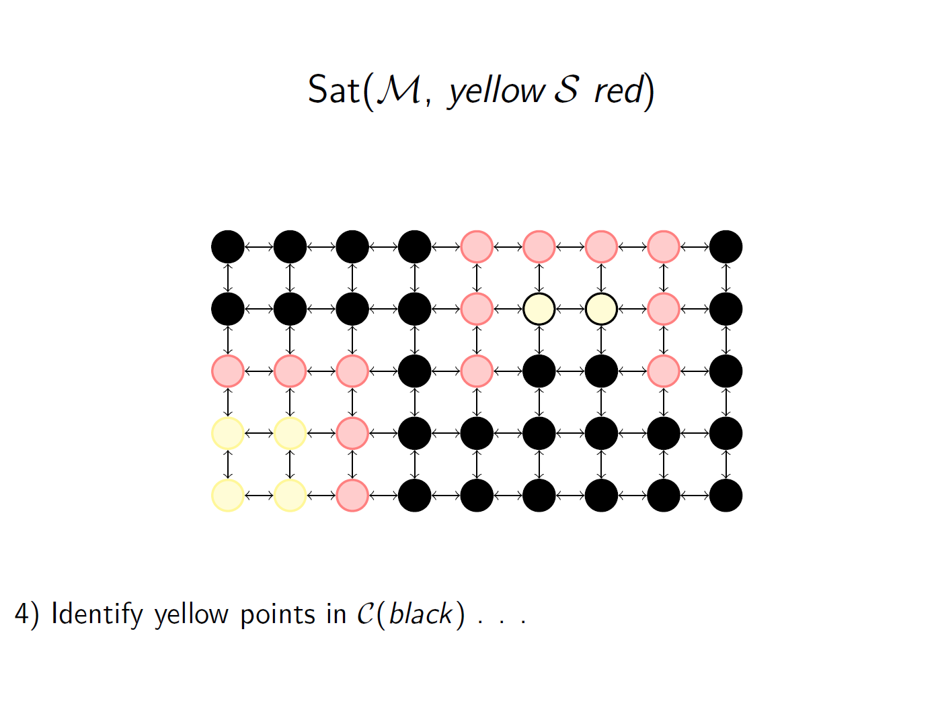
Example

Slide 15
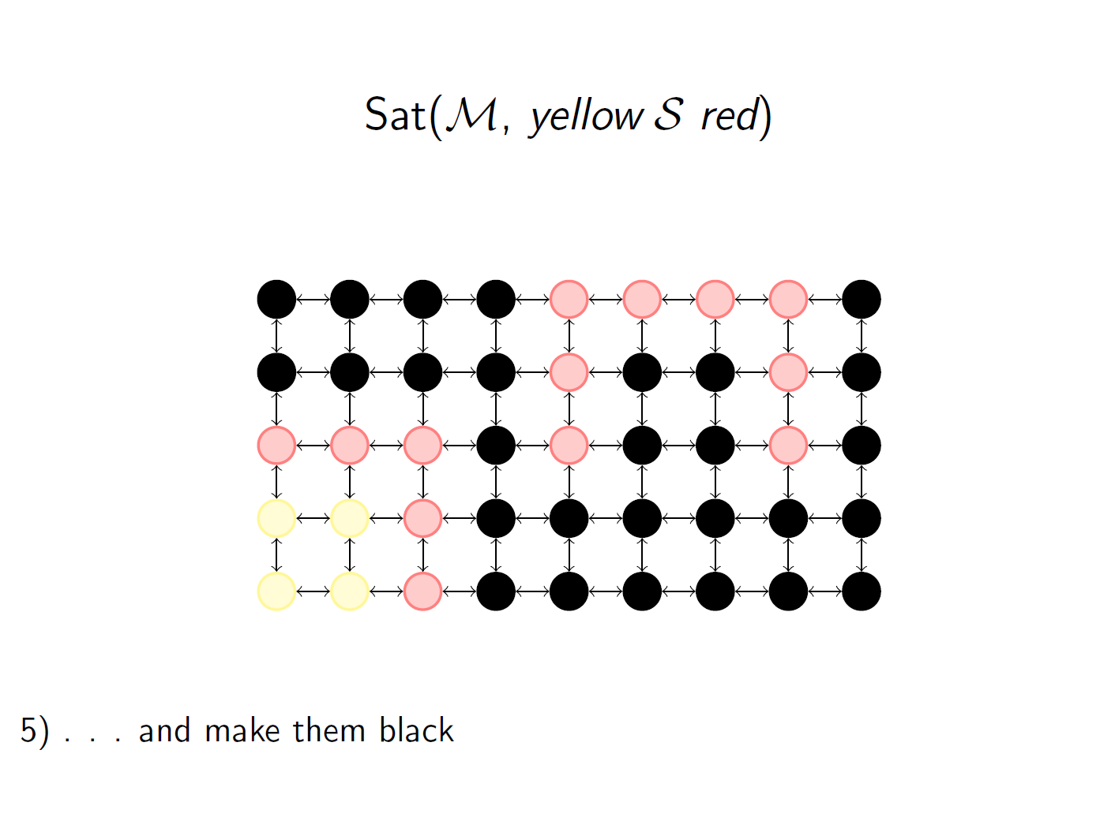
Example

Slide 16
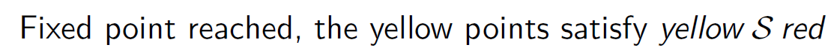
Example

Slide 17
VoxLogica (Voxel-based Logical Analyser)
Spatial Model Checker
Image analysis tool using logic language
Can reach state-of-art performance

Slide 18
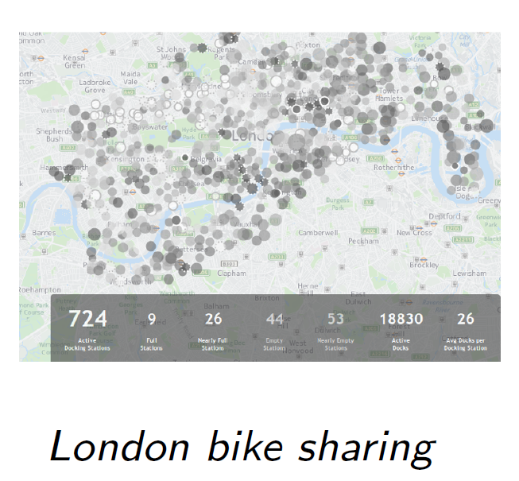
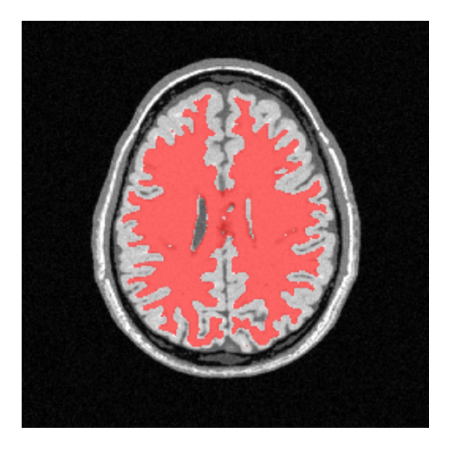
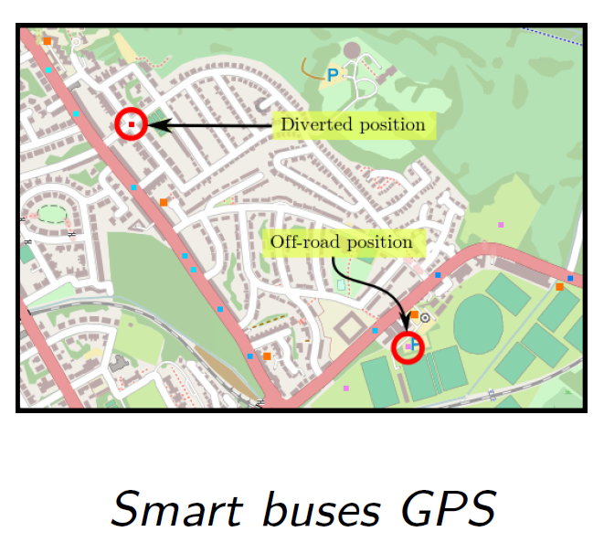
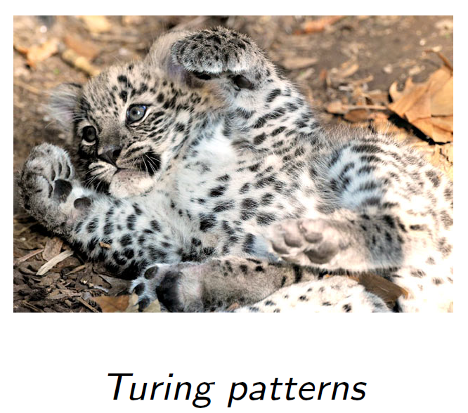
Existing Application
Bike sharing
Medical analysis
Smart Buses gps
Turing Pattern

Slide 19

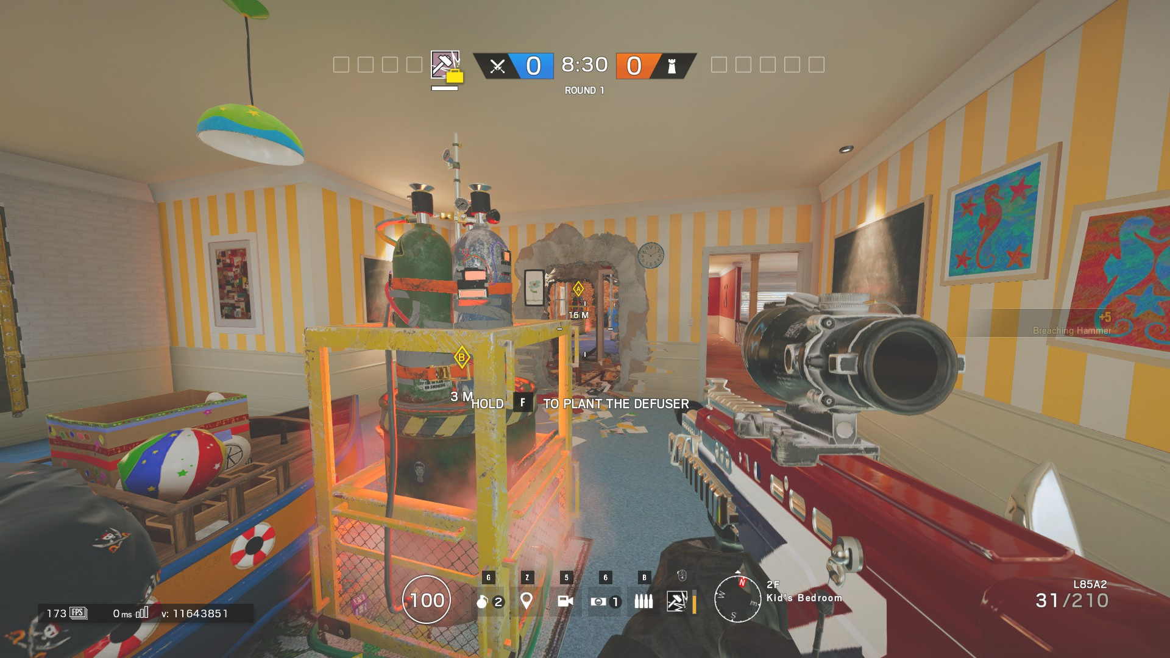
Rainbow Six Siege
First-Person Shooter (FPS) game
5 defenders and 5 attackers
Ranked mode : 2 bomb sites, 1 defuser

Slide 20
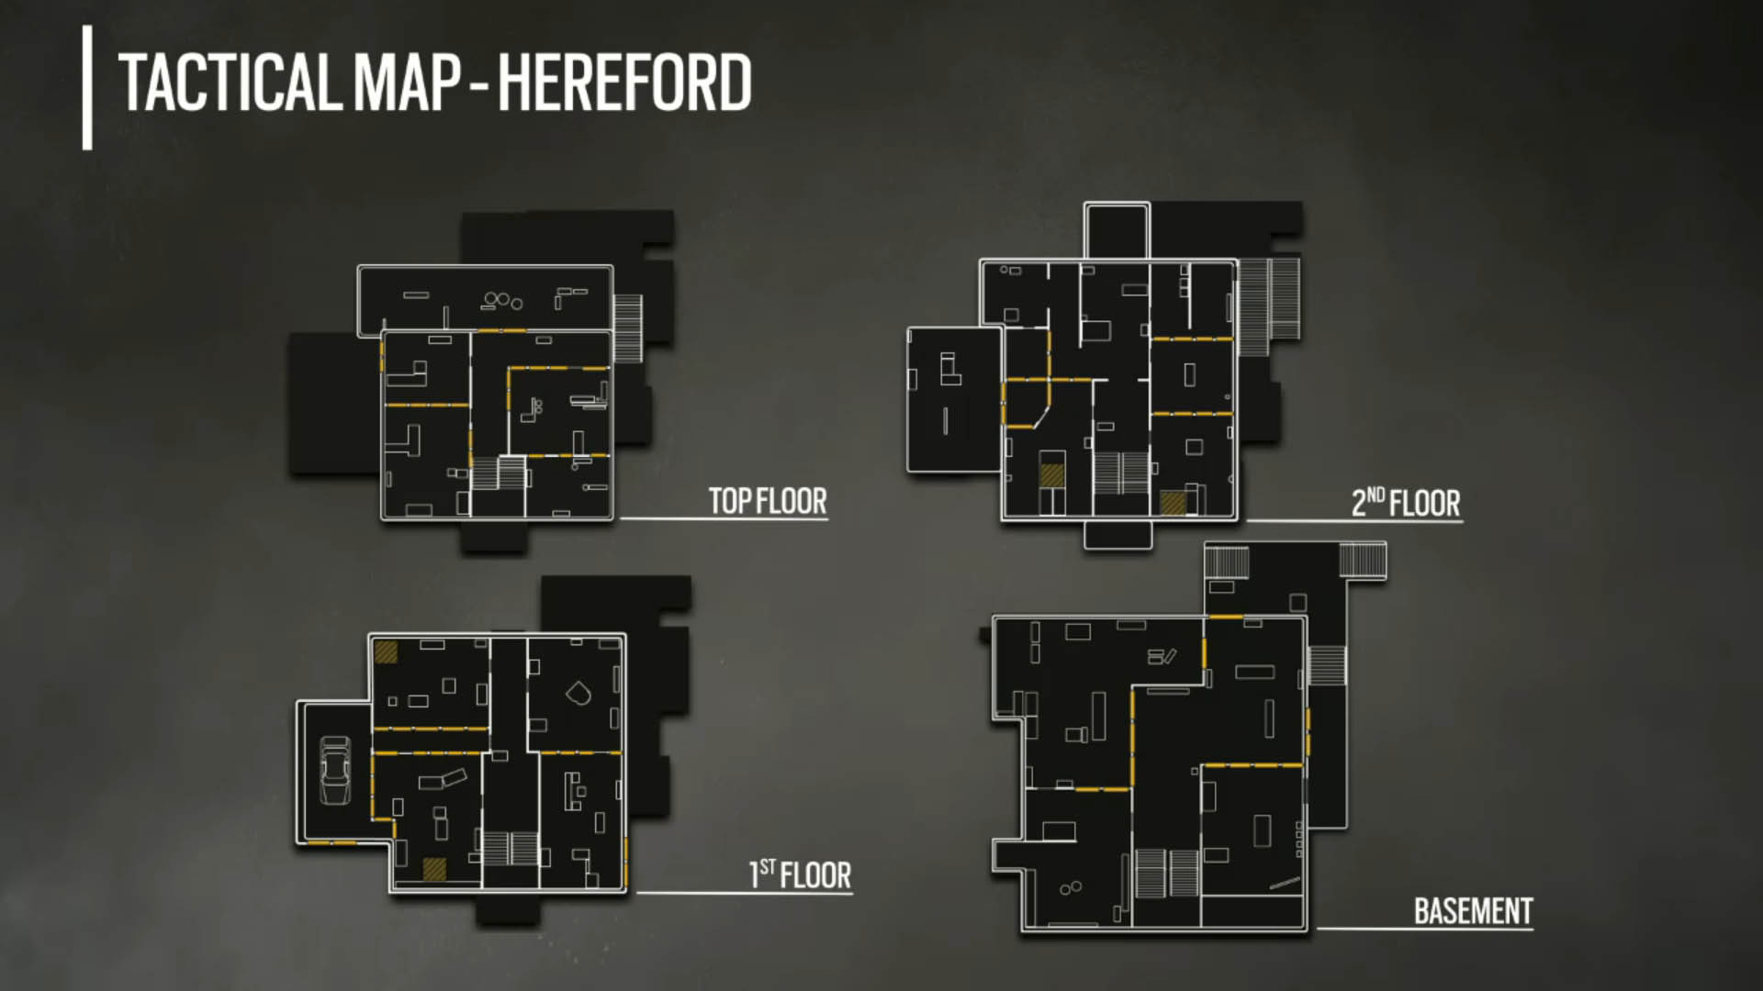
Map

Slide 21
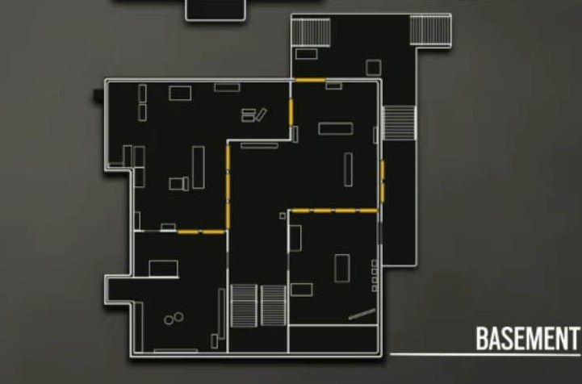
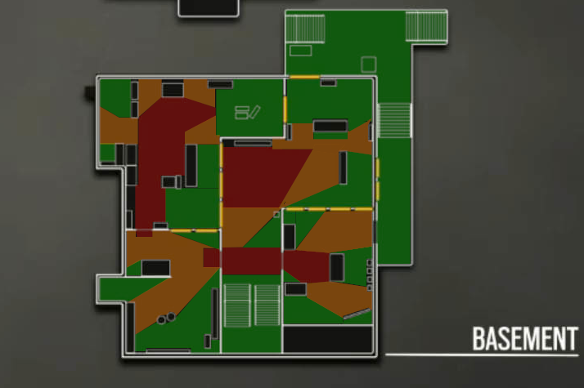
Our goal
Find the level of danger per region

Slide 22
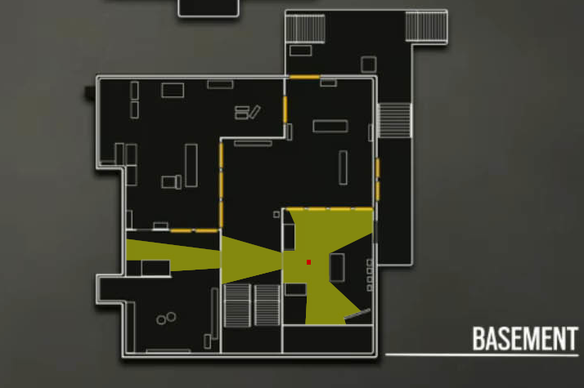
Solution proposed
Field of view (360°)
Big surface ⬄ high level of danger
Small surface ⬄ low level of danger

Slide 23
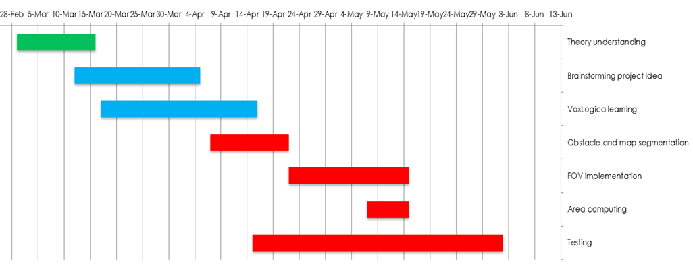
Agenda

Slide 24
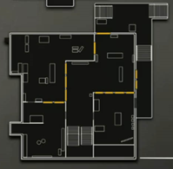
Original image

Slide 25
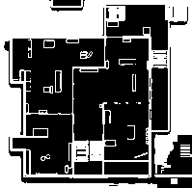
Segmented image

Slide 26
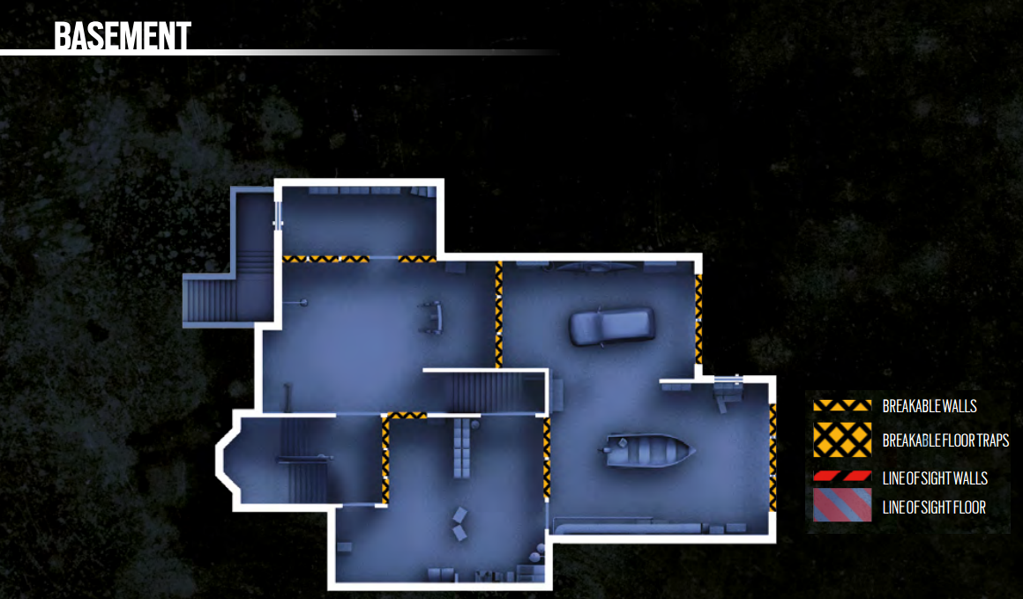
Better resolution

Slide 27
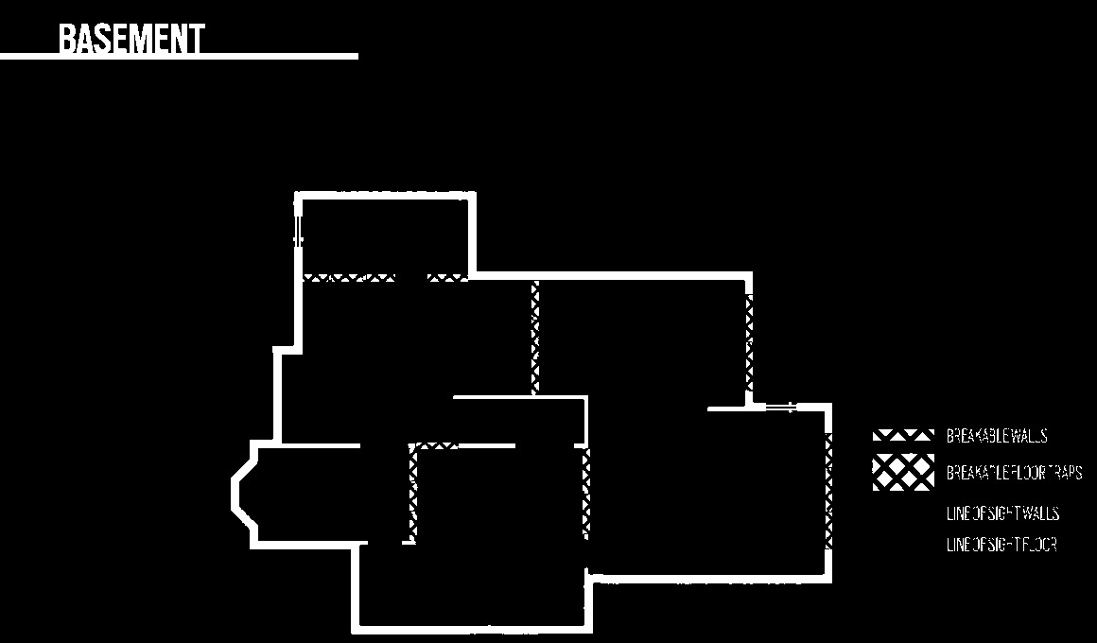
Segmentation

Slide 28
Problems…
Image quality
Obstacles segmentation
Voxlogica limitation

Slide 29

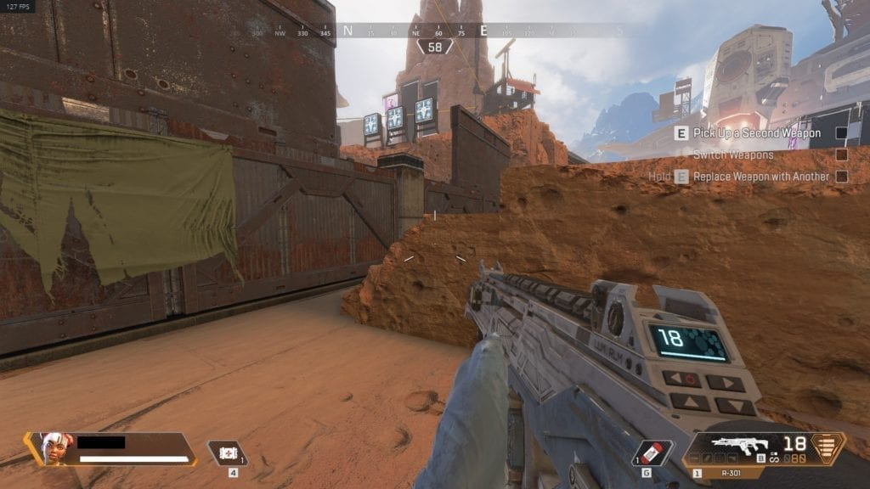
Apex Legends
First-person shooter (FPS) Battle Royale
20 squads of 3 members
Dropping from a plane

Slide 30
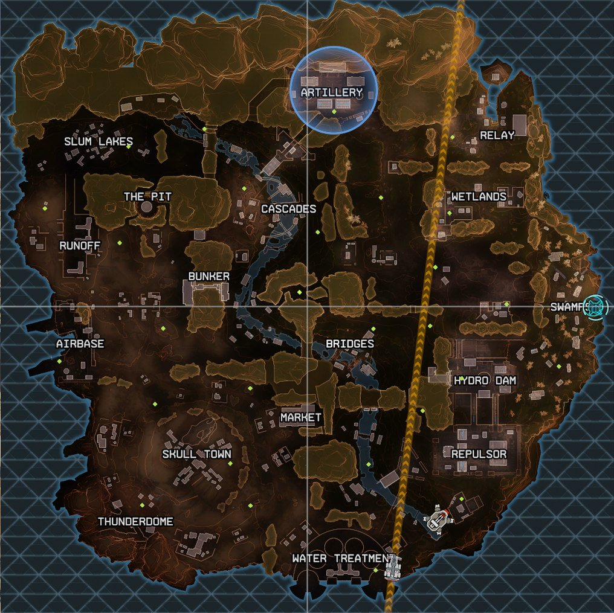
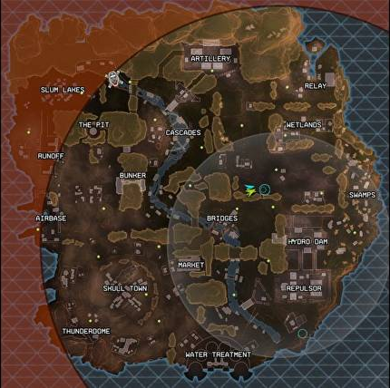
Drop and Safe

Slide 31
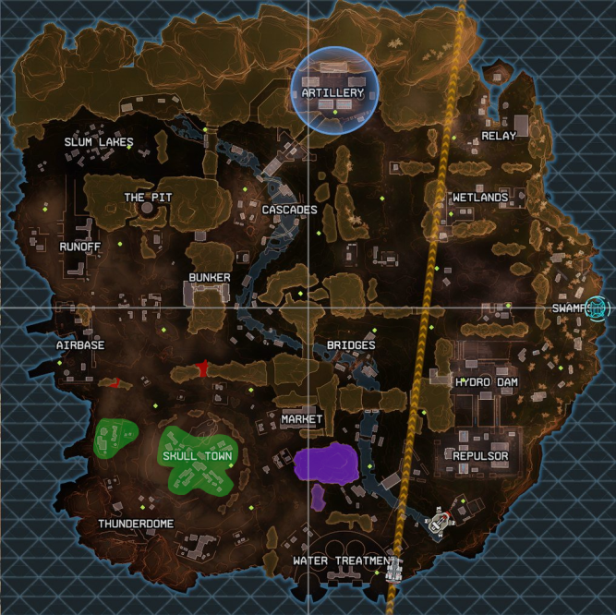
Buildings, Chokes and Mountains Segmentation

Slide 32
Find best area to drop
Loot time estimation
Dangerousness of area
Dangerousness of rotation to safe zone

Slide 33
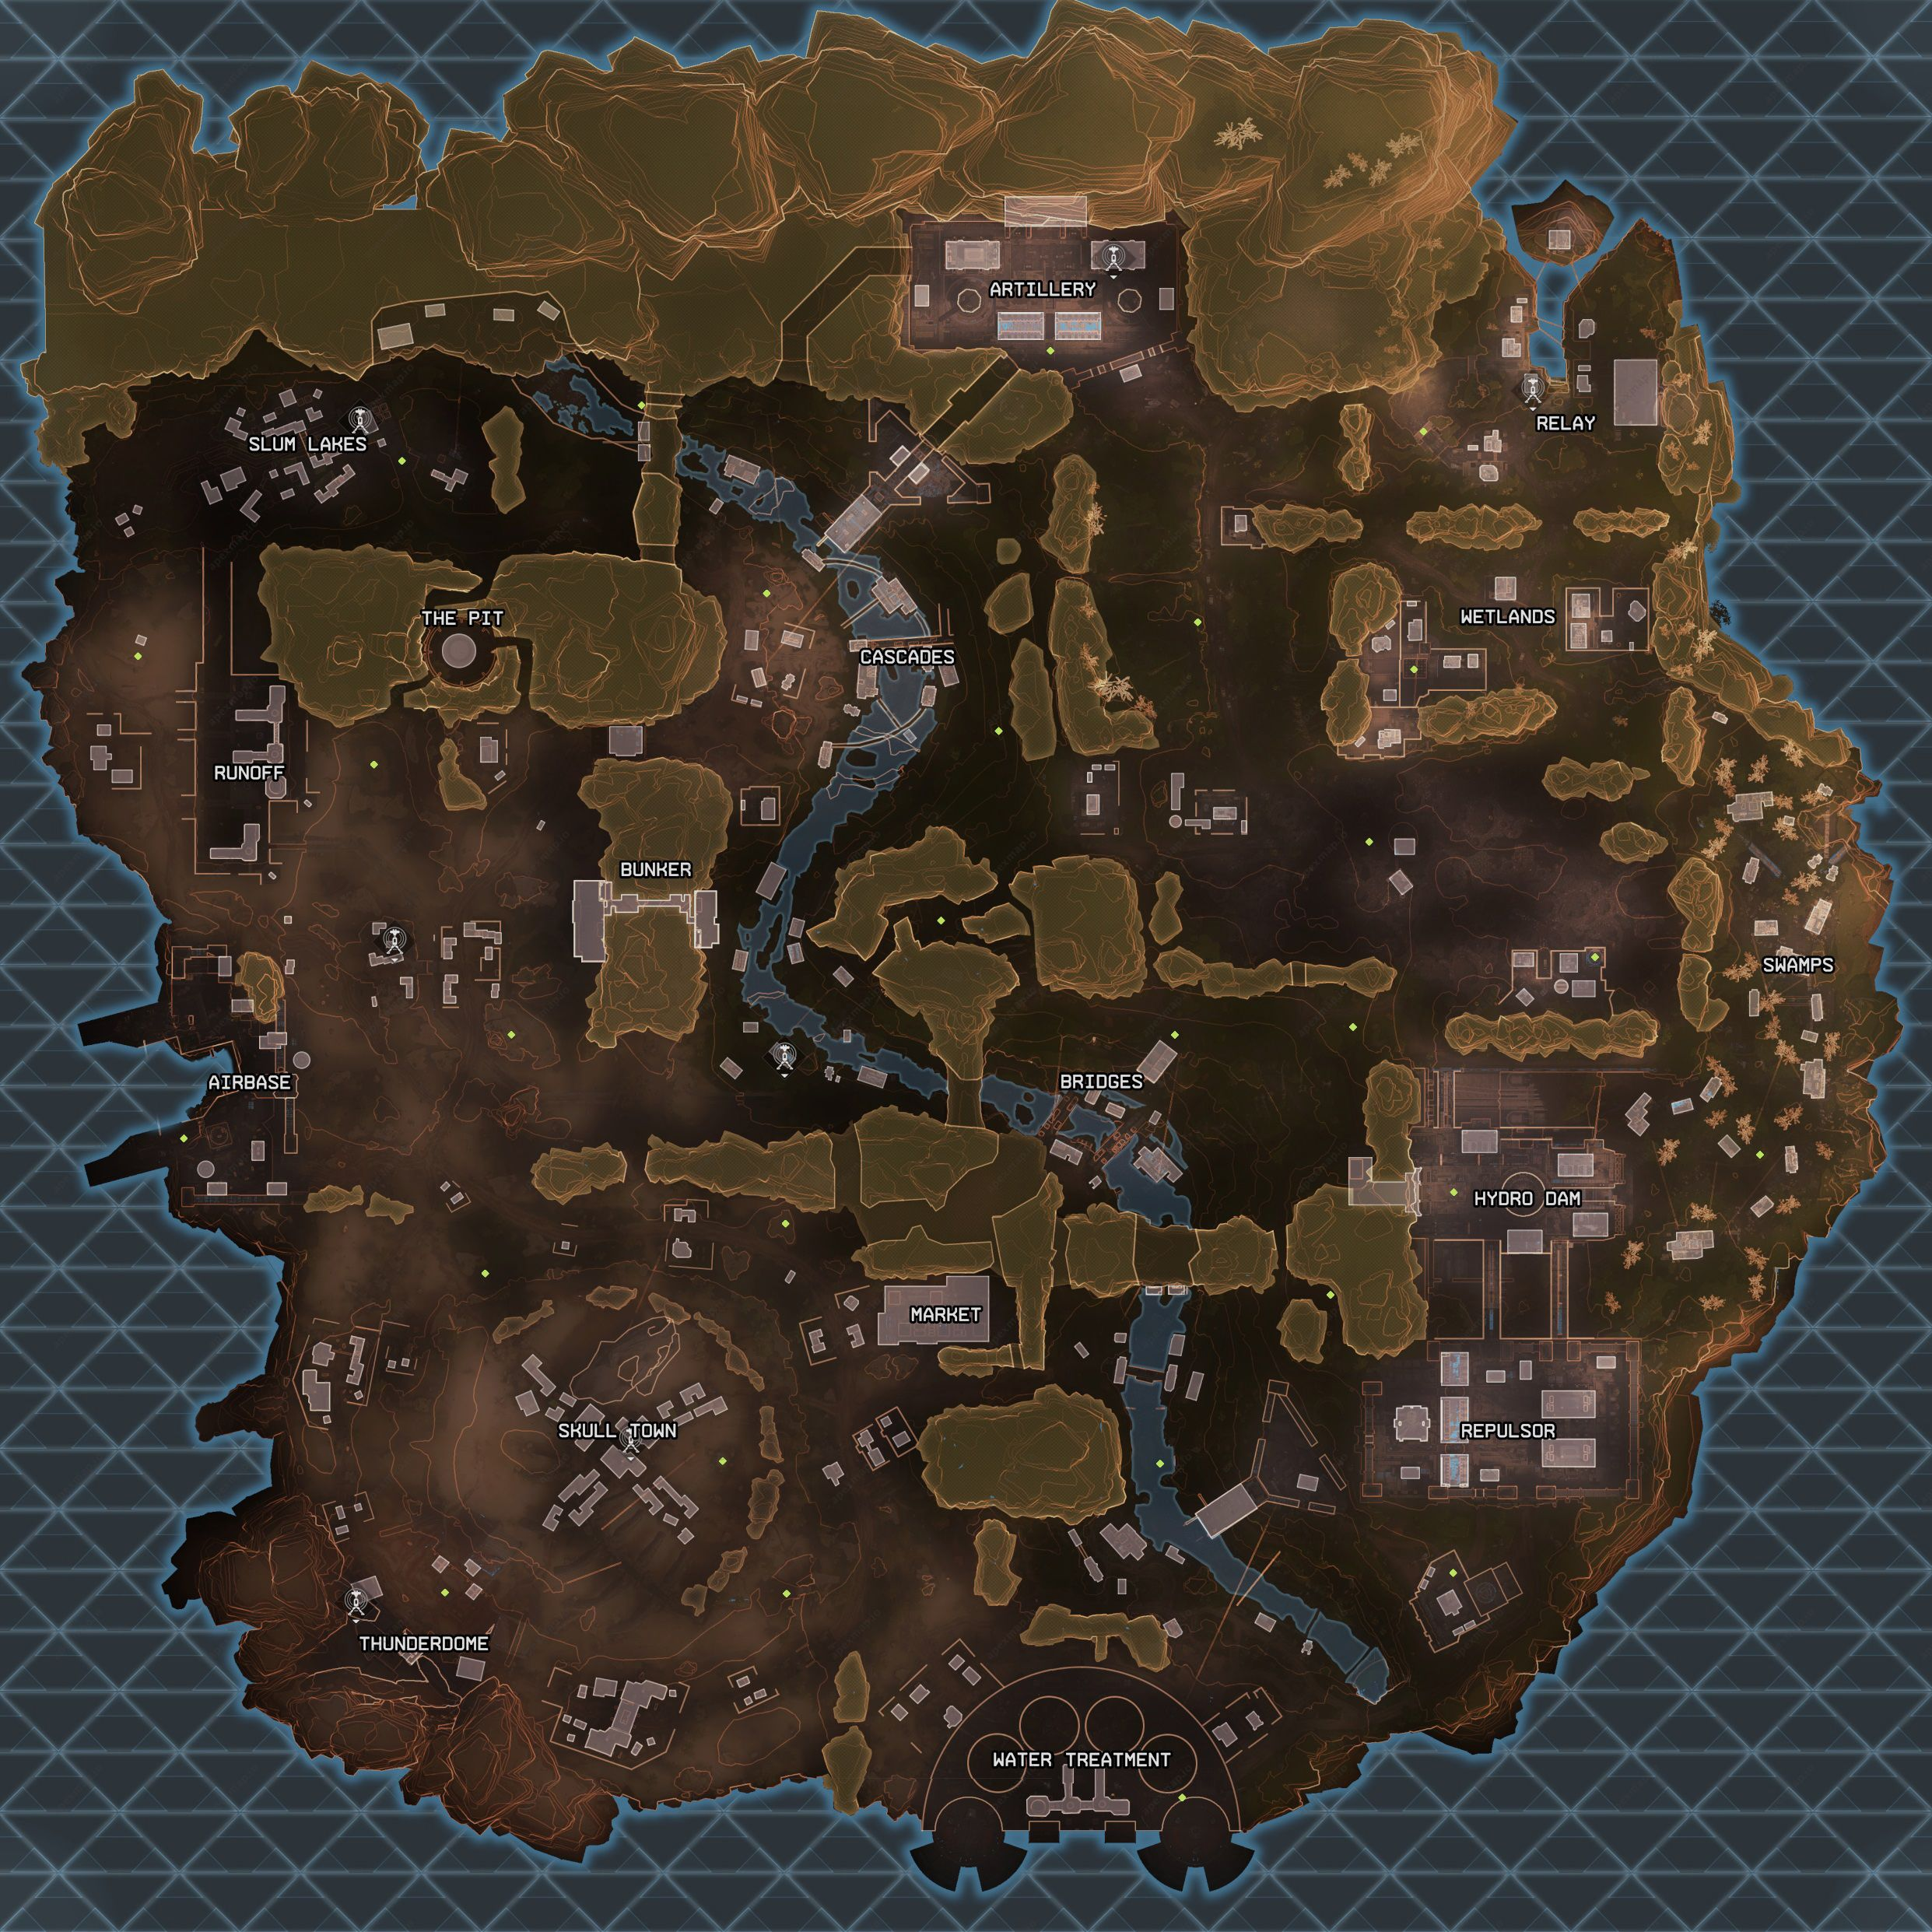
Slum Lake

Slide 34
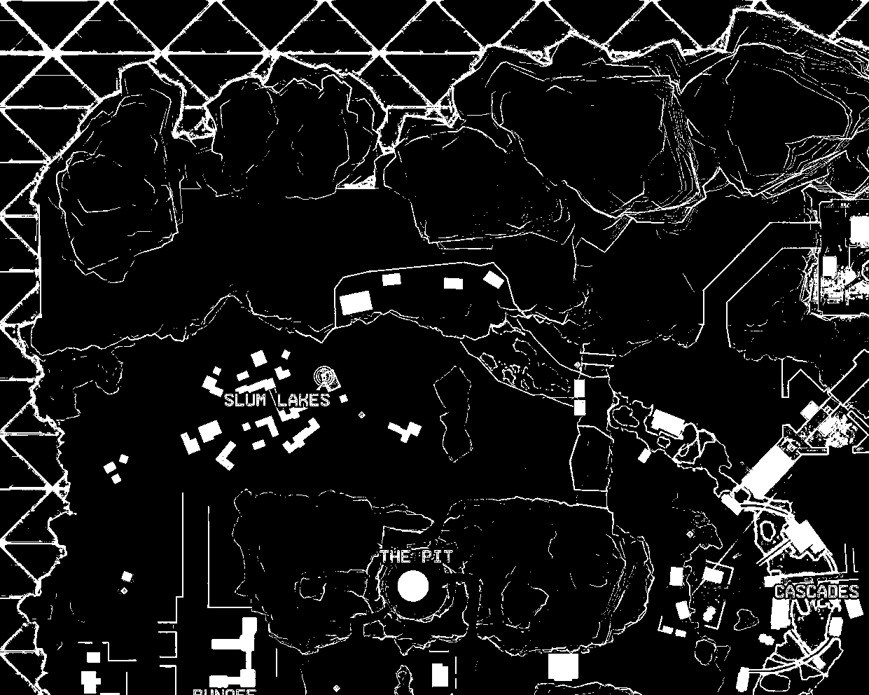
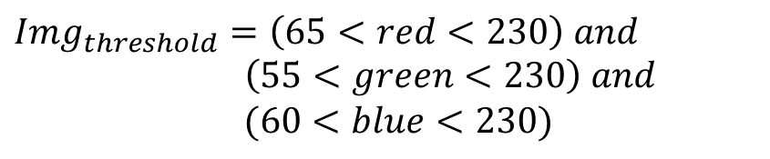
Color Threshold
$$Img_{threshold}=\left(65<red<230\right) and$$
$\left(55<green<230\right) and$
$$(60<blue<230)$$

Slide 35
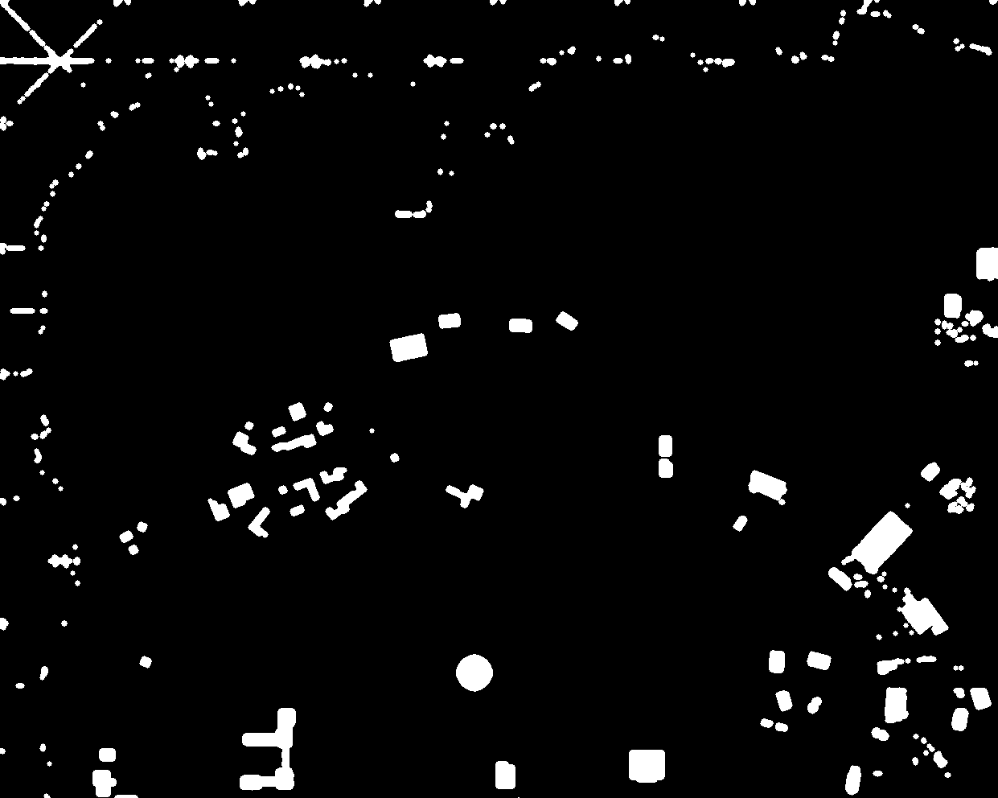
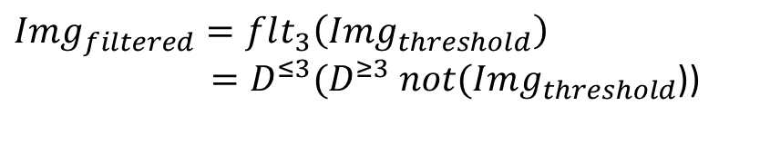
Smooth Filter
$$Img_{filtered}=flt_{3}\left(Img_{threshold}\right)$$
$=D^{≤3}(D^{≥3} not(Img_{threshold}$))

Slide 36

Zone definition
$$Zone=D^{≤160} Slum_{centers}$$

Slide 37

Segmentation
$SlumBuildings_{binary}=Img_{filtered} and Zone$

Slide 38

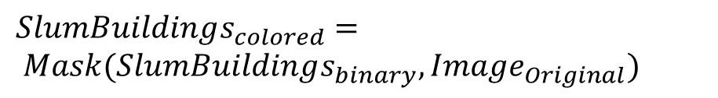
Slum Buildings
$$SlumBuildings_{colored}=$$
$$Mask(SlumBuildings_{binary}, Image_{Original})$$

Slide 39
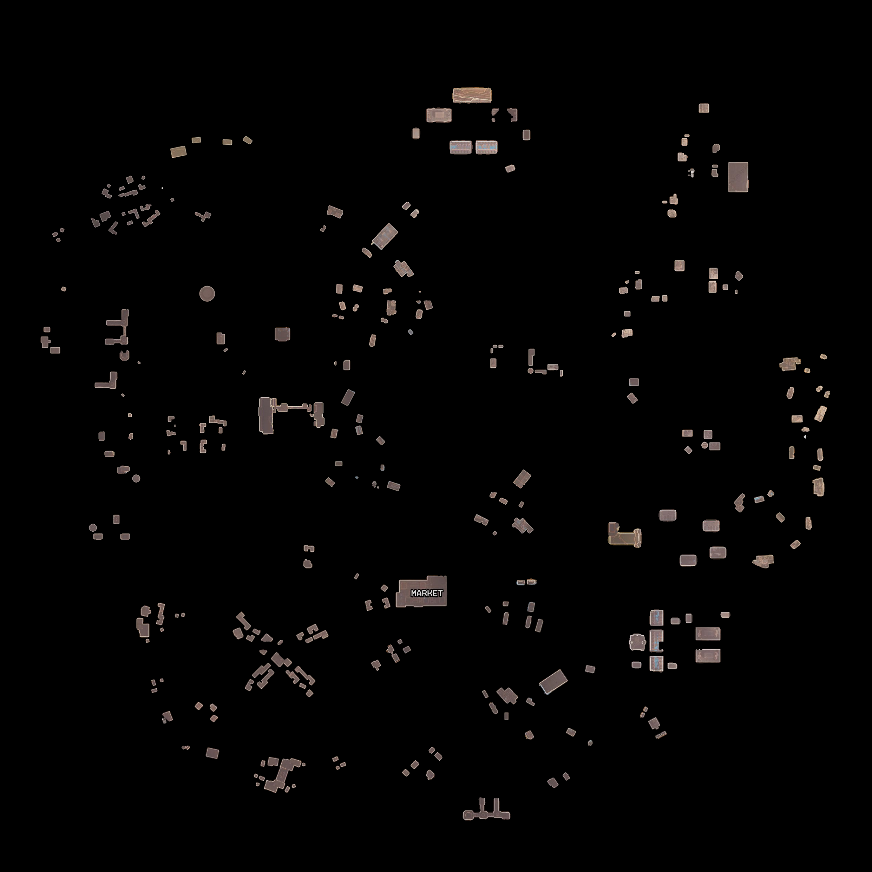
Final segmentation

Slide 40
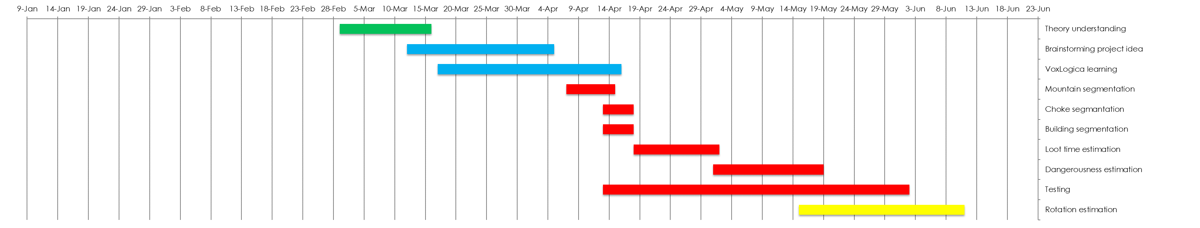
Agenda

Slide 41
Topological Reasoning
Jonathan Lo, Tommaso Peletta, Adrien Razurel

